Slide 1



Beyond the Road
A Data-Driven Analysis of US Car Accidents
Asawari Kadam
Prachi Kotkar
Akash Bharsakle
Ajinkya Desai
Group 1

Slide 2



Introduction
US Car Accidents (2016 - 2023)
This is a dataset on nationwide traffic accidents including data from 49 states in the US.
It originally included 7.8 million car accident records and 47 columns before data cleaning and preprocessing.
The dataset includes information on factors like location, time, weather conditions and severity of an accident.
We have used these attributes to analyze the circumstances of the accidents, draw insights from it and recommend managerial insights based on certain assumed attributes.

Slide 3
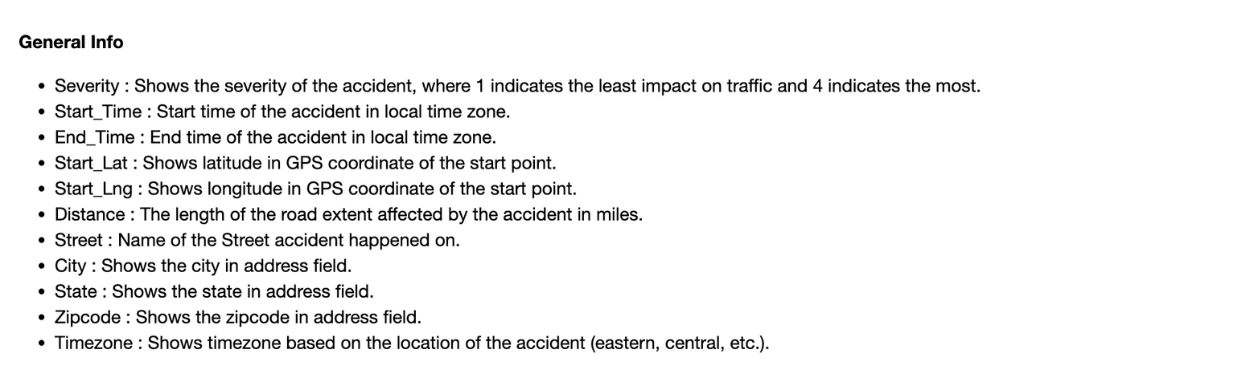
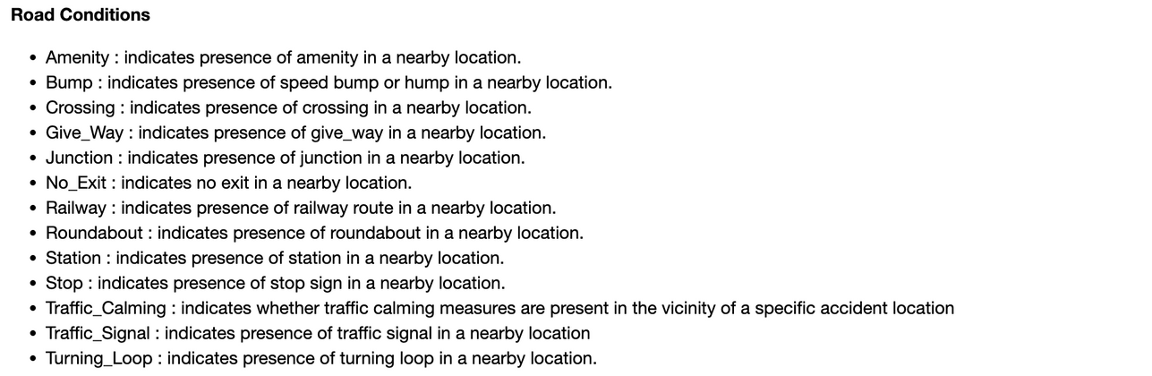
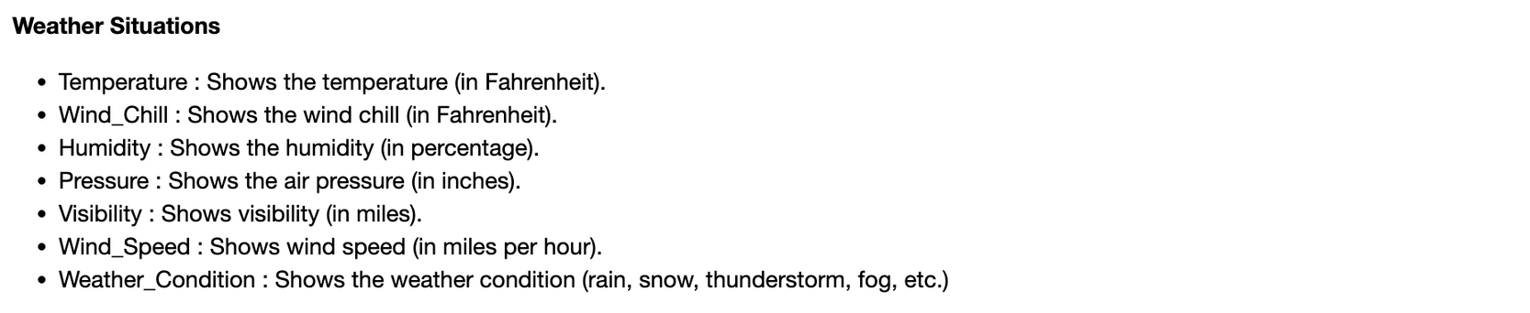


Dataset Introduction

Slide 4
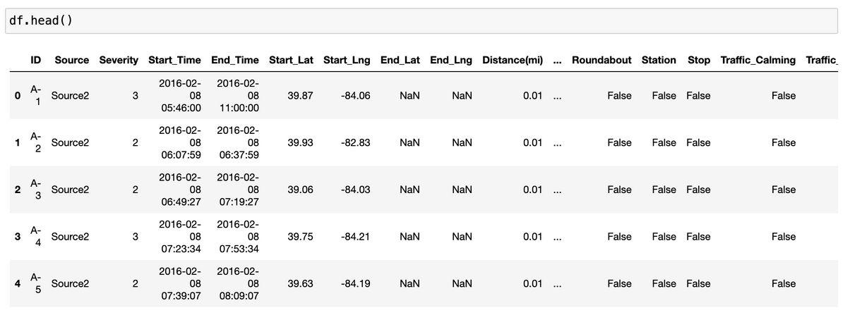
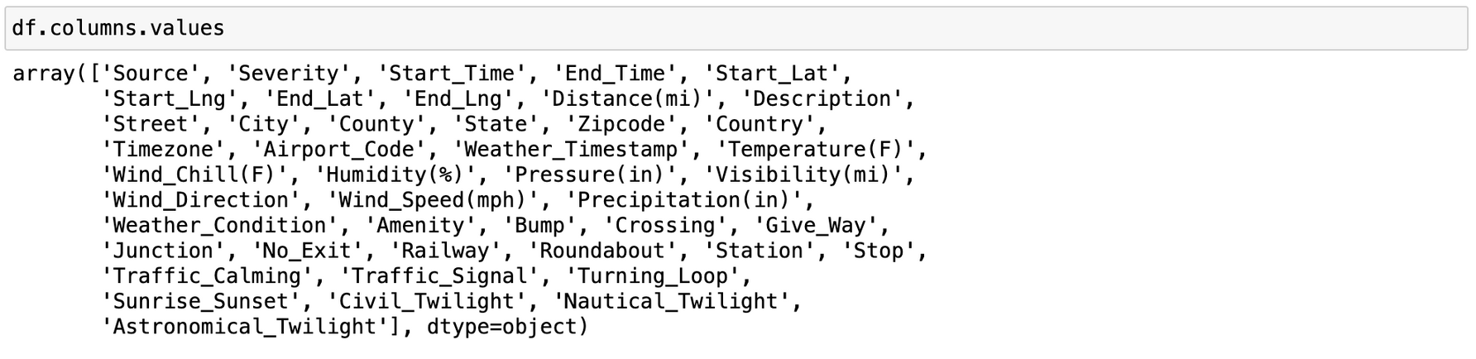
Overview of the Dataset

Slide 5
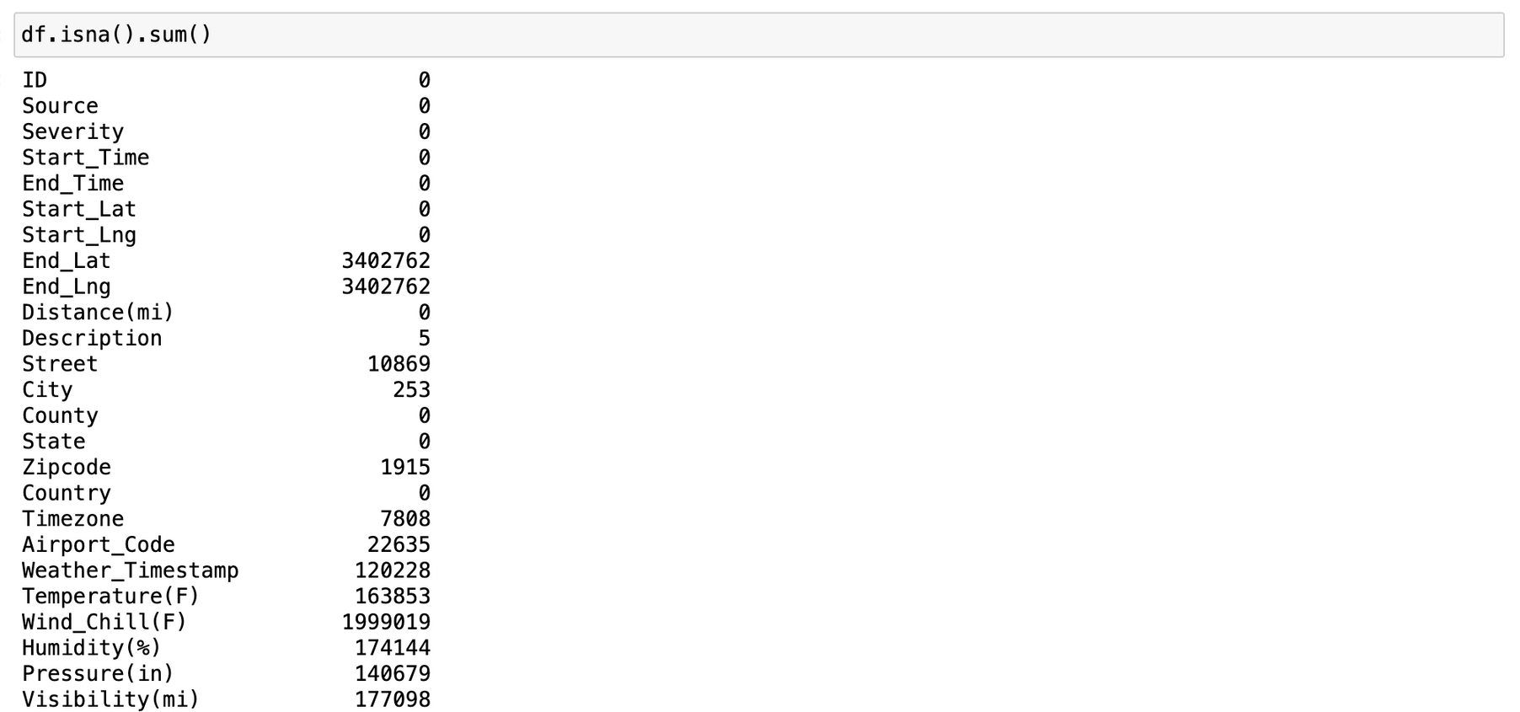
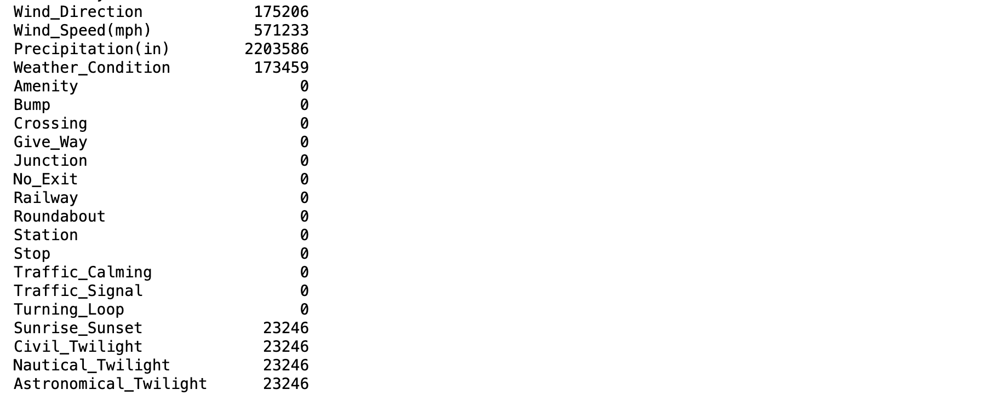

Data Cleaning

Slide 6
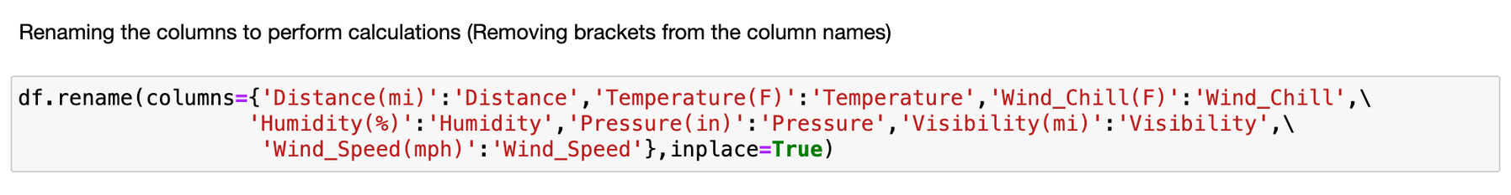
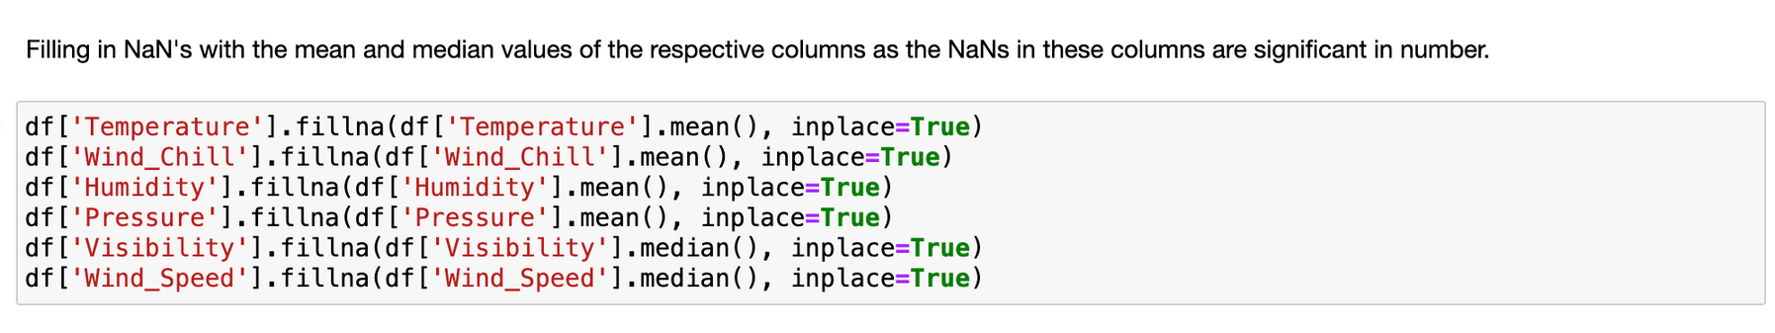
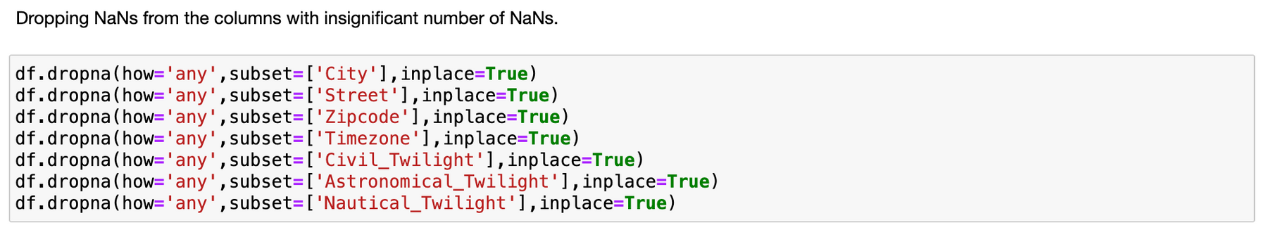

Slide 7
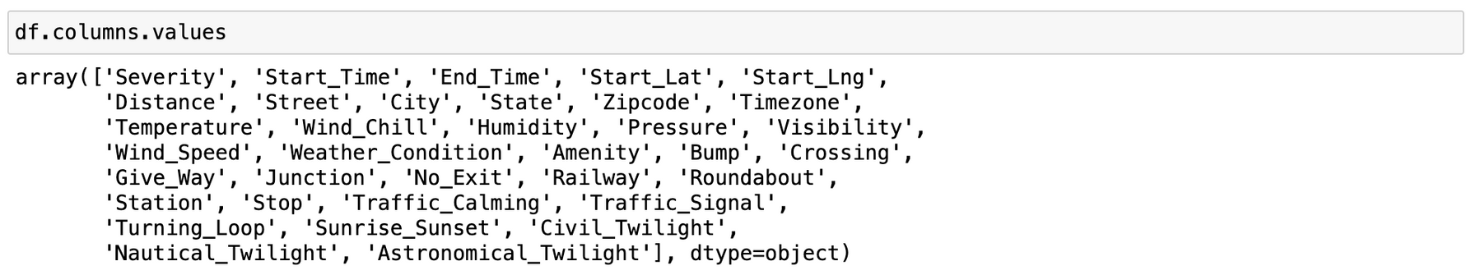

Slide 8
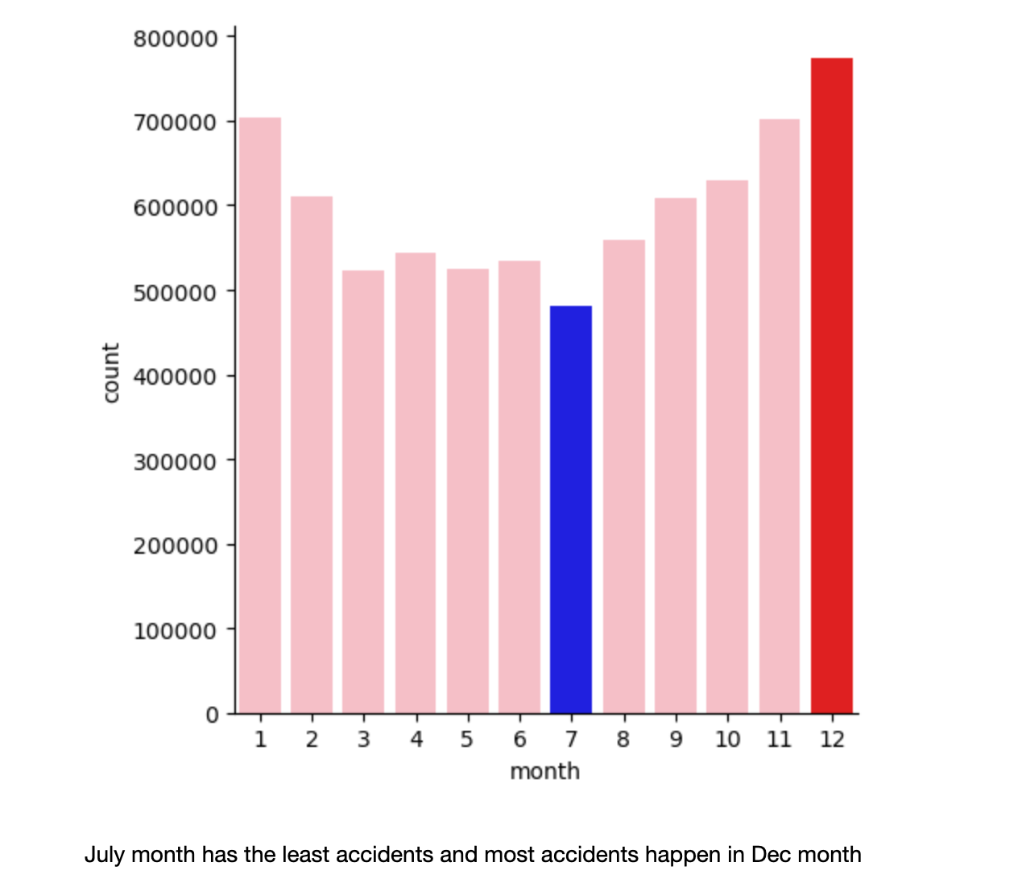
July month has the least accidents and most accidents happen in December month

Slide 9
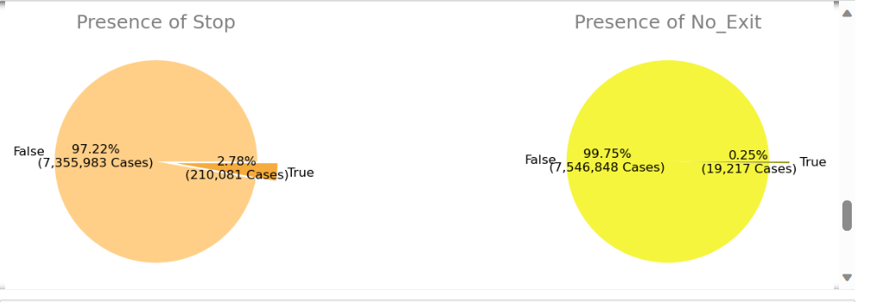
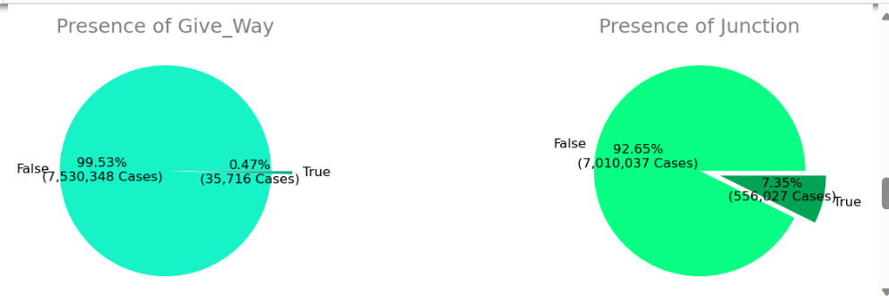
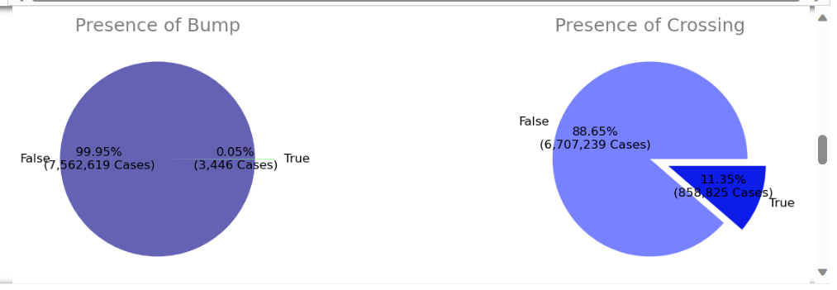
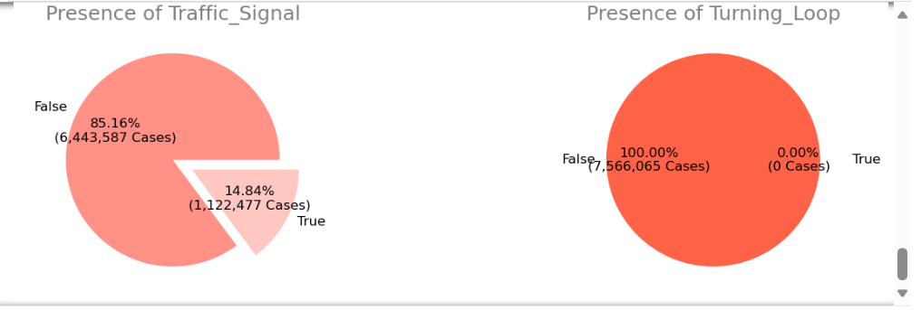
1.ANALYSIS BASED ON ROAD INFRASTRUCTURE
14.85(TS) + 7.35(Jnc) + 11.35 (Cro)= 33.54

Slide 10
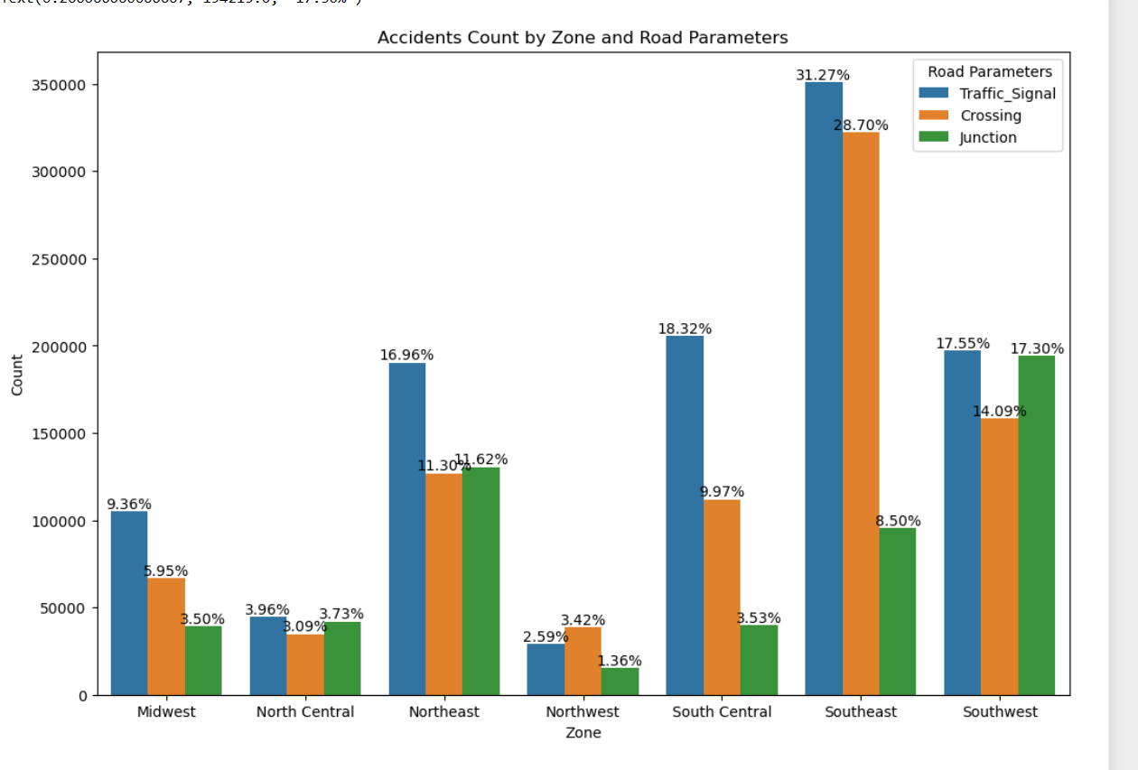
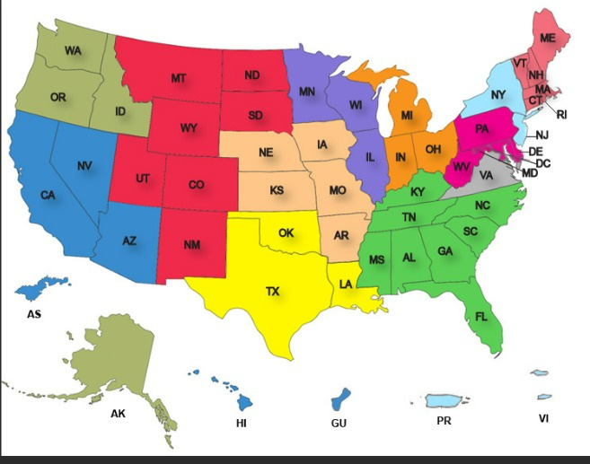
Florida
Georgia
North Carolina
South Carolina
Alabama
Mississippi
Lousiana
Arkansas
Tennessee

Slide 11
Recommendation
Implement a comprehensive traffic management and infrastructure improvement plan in the Southeast zone, with a specific focus on intersections with traffic signals, junctions, and pedestrian crossings.
This plan should include:
1. Enhanced Traffic Signal Management: Review and optimize the timing and operation of traffic signals to improve flow and reduce congestion. Implement such as adjusting road layouts, adding or modifying lanes, or introducing smart traffic management technologies.
2. Safety Measures at Junctions and Crossings: Introduce additional safety measures at junctions and crossings, such as better signage, pedestrian crossing alerts, and improved road markings. This can enhance visibility and awareness for both drivers and pedestrians, reducing the likelihood of accidents.
3. Proper Allocation of Budget for these improvements
4. Availability of emergency services in these areas

Slide 12
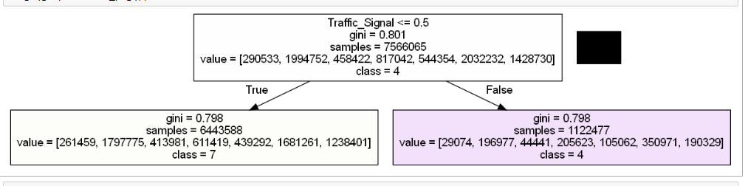
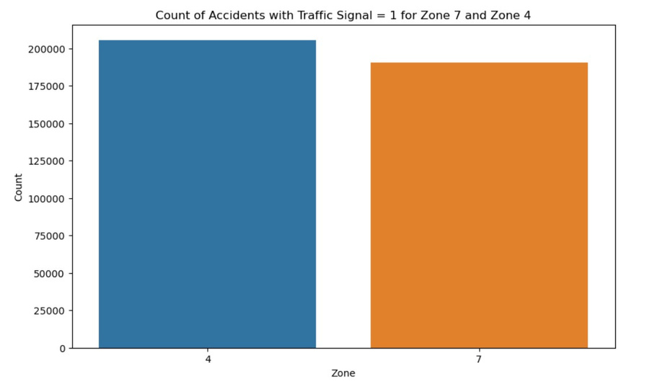

Slide 13
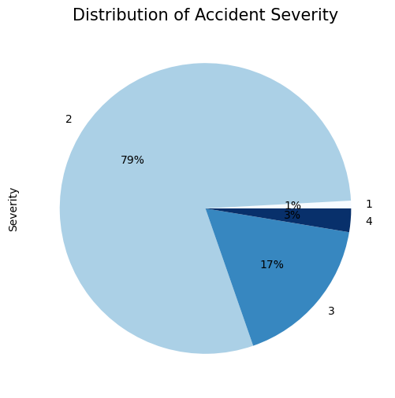
2. ANALYSIS BASED ON SIGNAL BUMPS/SPEED BREAKERS
79% are of lower severity, with a small proportion resulting in higher severity.

Slide 14
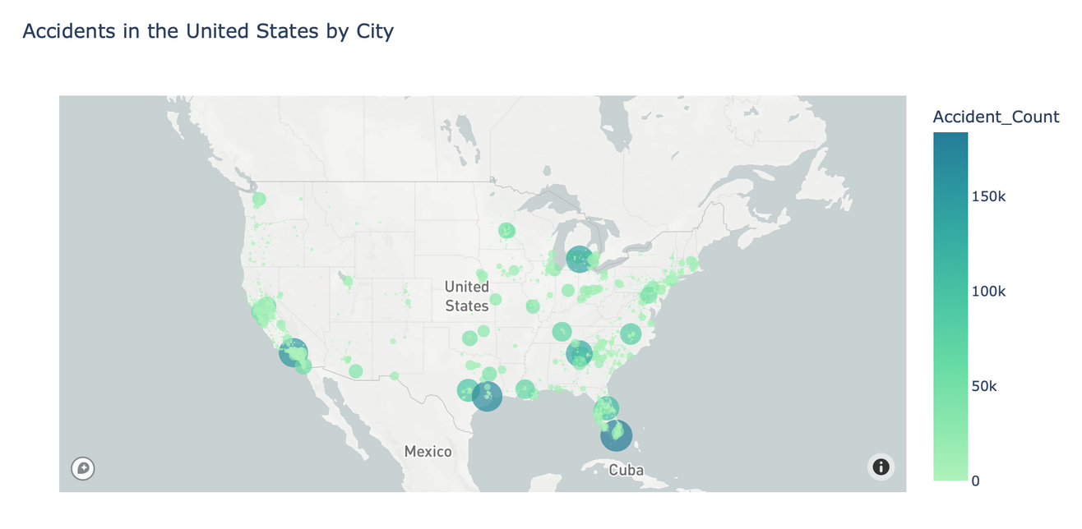
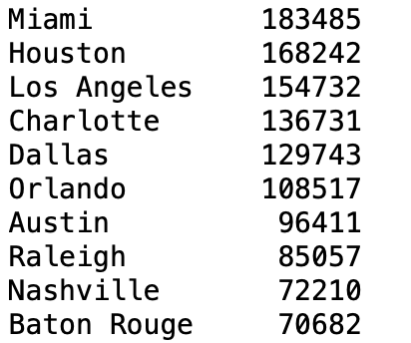
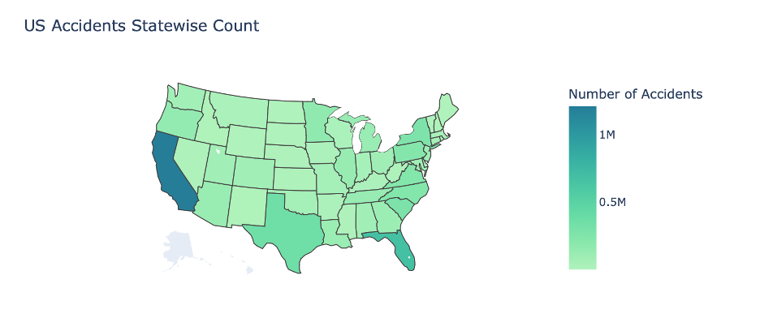
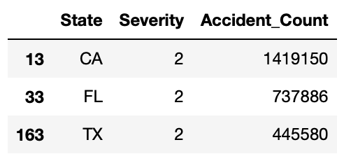
Most accidents happening in major cities and states
Miami, Los Angeles, Houston has high concentration of road accidents
California, Texas, Florida have significantly higher accident counts with most cases of Severity 2.

Slide 15
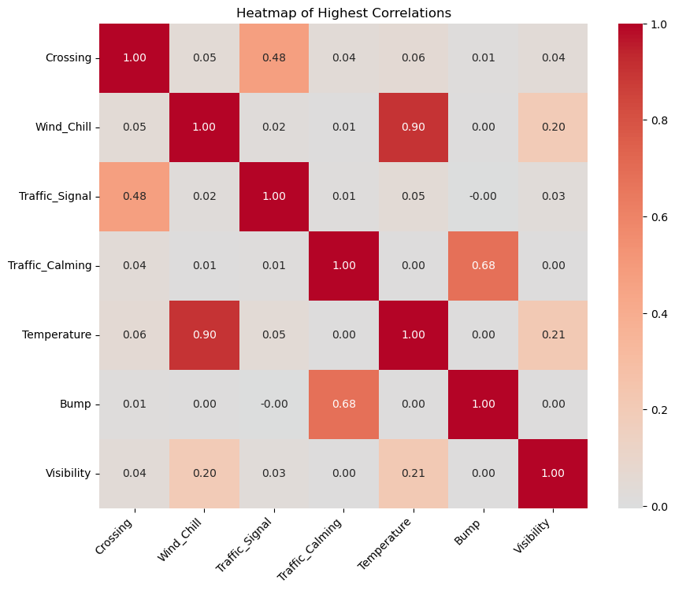
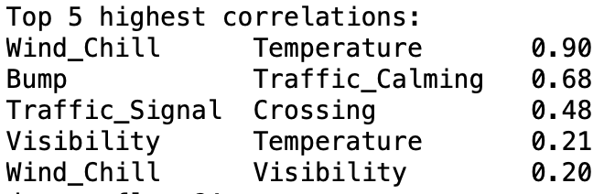
Temperature and Wind Chill: There is a high positive correlation between temperature and wind chill, which is expected as they are both related to weather conditions.
Traffic Calming and Bump: Traffic calming measures have a strong positive correlation with the presence of bumps. This indicates that bumps are a commonly used traffic calming measure.

Slide 16
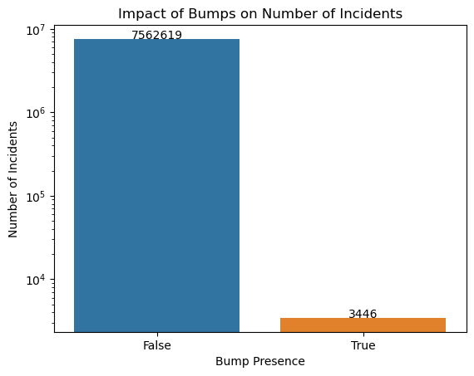
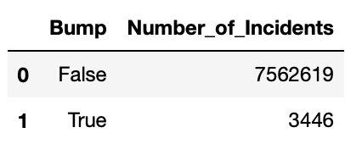
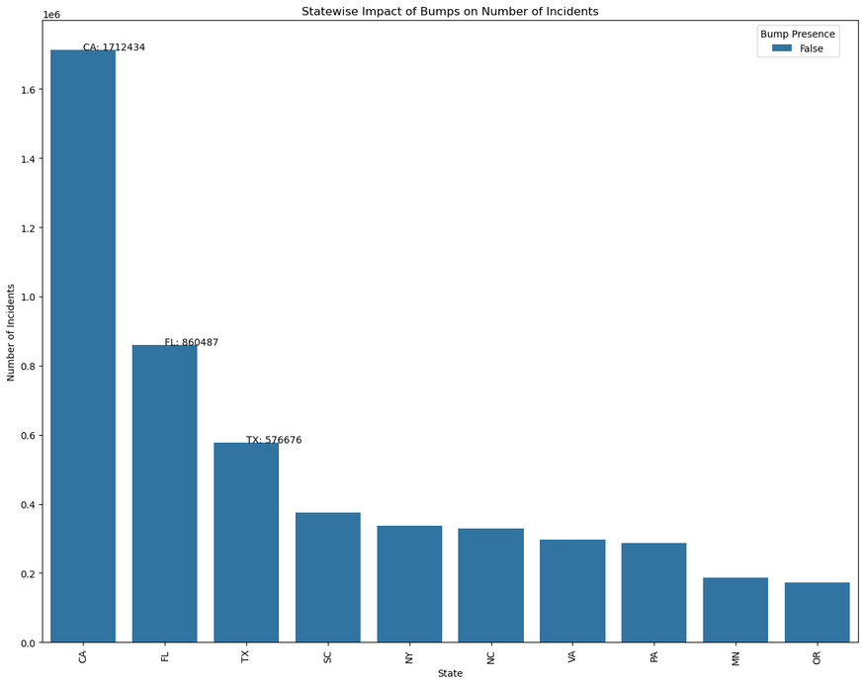
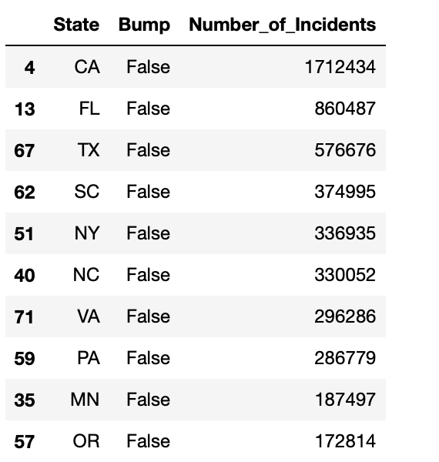
The absence of Signal bumps increases the number of accidents significantly

Slide 17
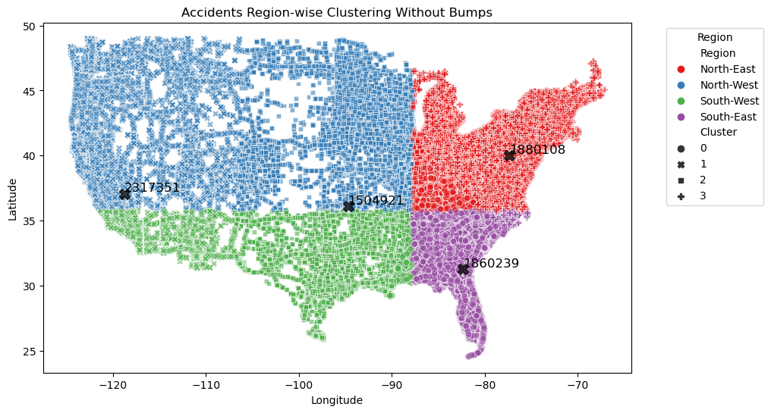
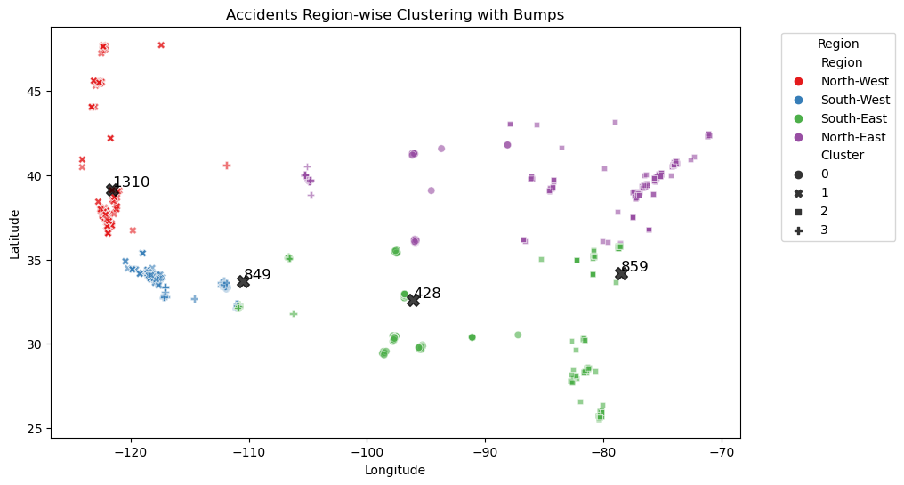
Summary of Finding: Regions with signal bumps tend to have lower accident counts, indicating that bumps may contribute to road safety.
Validity of Finding: The clustering figure shows clear patterns where regions with signal bumps (represented by different colors) have varying accident counts.
Managerial Insights: Get more bumps! The government should increase the number of signal bumps in high-accident areas could effectively reduce accident rates. Companies involved in road safety solutions could see increased demand for signal bumps and related traffic-calming products.

Slide 18
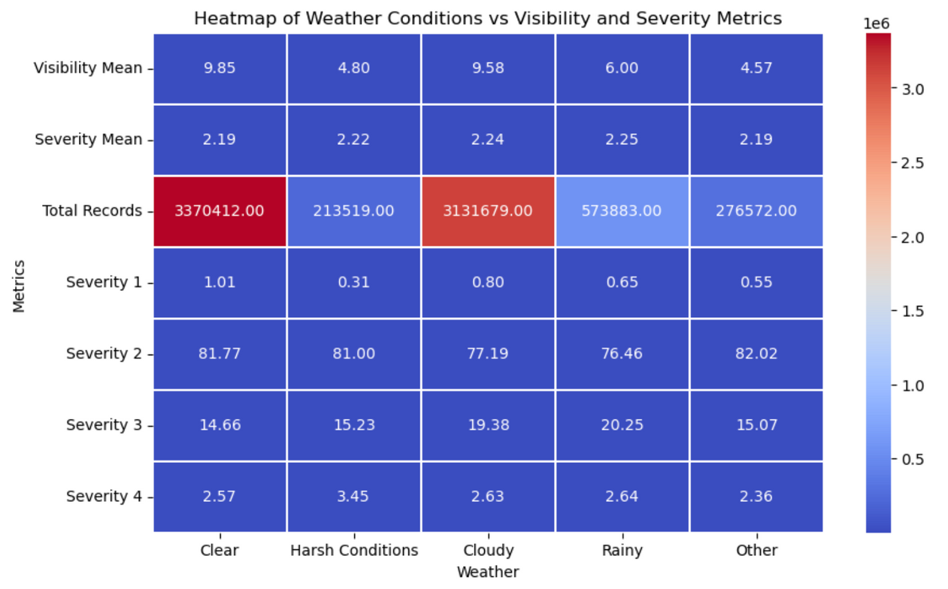
3. Weather Conditions Vs Severity Vs Visbility Metric
Key Insights
1. Harsh Conditions show a significantly lower visibility mean, which suggests that harsh weather conditions can substantially reduce visibility.
2. The severity mean does not vary significantly across different weather conditions, indicating that the weather might not drastically change the average severity of occurrences.
3. Higher severity accidents for Cloudy Weather are much higher as compared to Clear Weather even after having the similar Visibility Mean.

Slide 19

Managerial Insights (Impact on ADAS):
1. Enhanced Visibility:
In Harsh Conditions, where visibility is significantly reduced, ADAS features like adaptive headlights, night vision systems, and forward-collision warnings can assist in detecting obstacles on the road and help prevent accidents.
2. Adaptive Functionality:
The differences in weather conditions imply that ADAS systems could benefit from being adaptive, adjusting their sensitivity and response patterns based on real-time weather data to optimize safety. For example, traction control systems can adjust to provide better grip in rainy conditions, and lane-keeping assist can be more or less assertive depending on visibility and road conditions.
3. Predictive Alerts:
In Cloudy or Clear weather conditions where visibility may be good but other factors may contribute to accidents, predictive alerts from ADAS can inform drivers about potential hazards or changes in driving conditions ahead.
4. Data-Driven Development:
The findings from this data analysis can be used to inform the development of ADAS technologies, ensuring they are designed to address the specific challenges presented by different weather conditions.

Slide 20
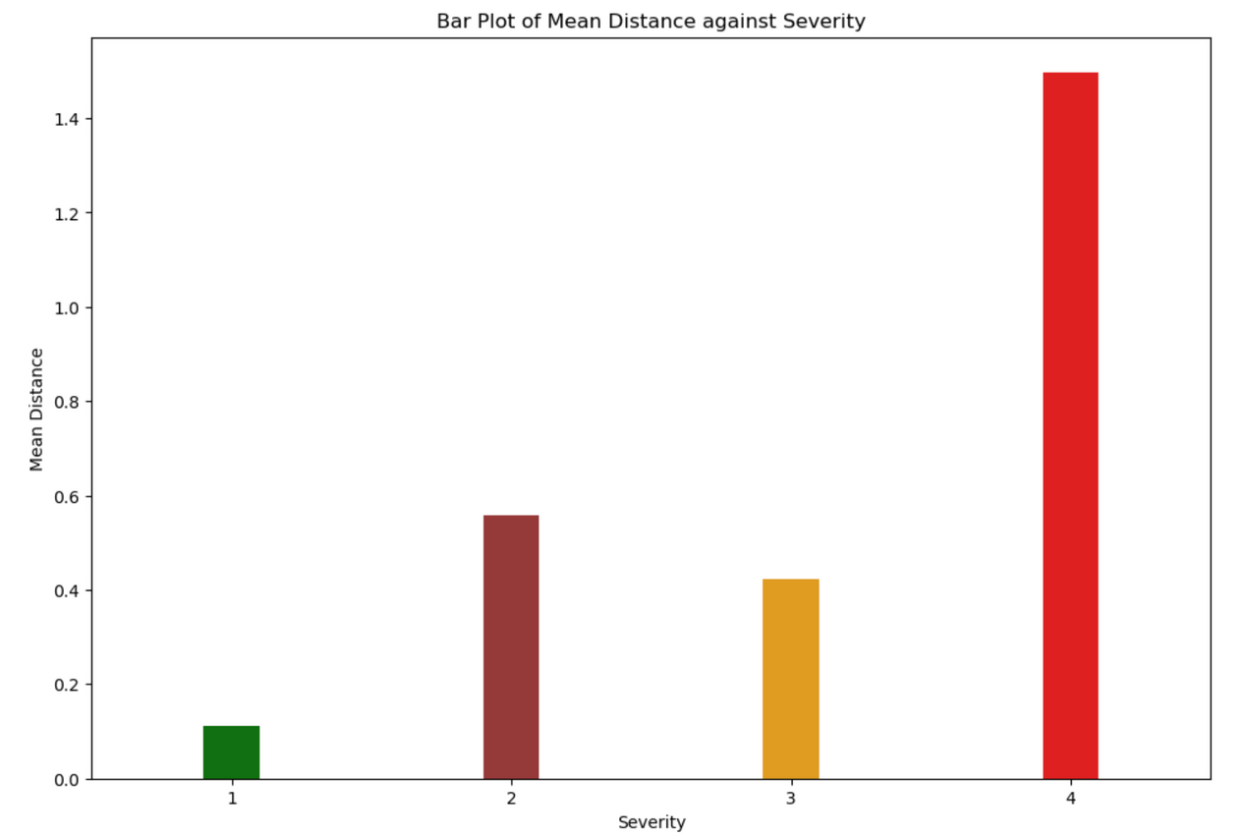
Distance(mi) Vs Severity Analysis:
Key Insight(Expected): Severity 1 accidents have the shortest mean distance impacted, while Severity 4 accidents impact significantly longer stretches of road. This could indicate that accidents with high severity tend to involve larger areas, potentially due to factors such as more vehicles being involved.
Interesting finding:
Severity 2 accidents, while not the most impactful in terms of traffic delay, affect a longer stretch of road than Severity 3 accidents.

Slide 21

Thank you!
Be Safe out there!

